Slide 1
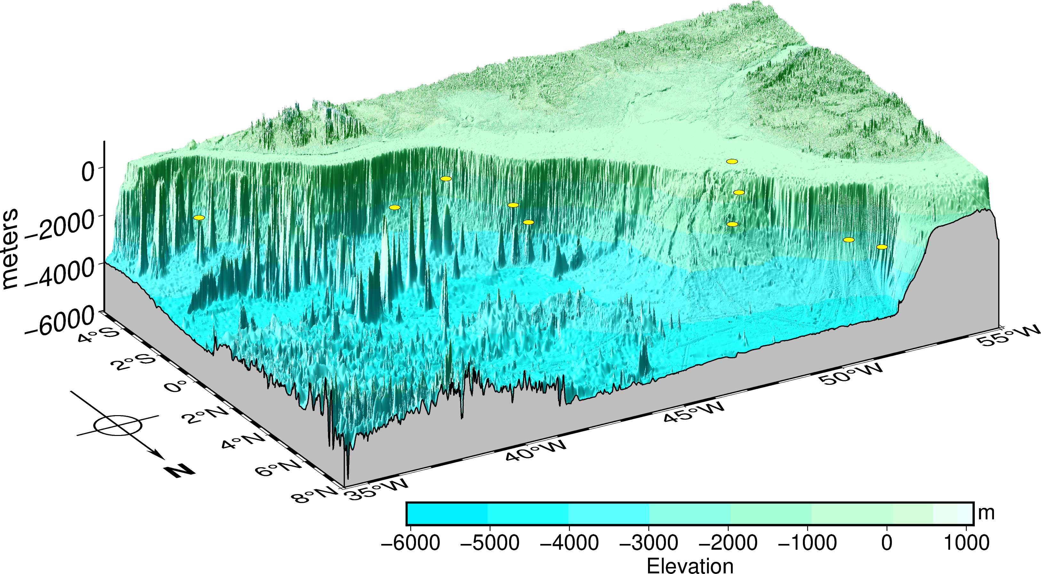
AMARILLYS-AMAGAS
Leg 2
S10
[70 m]
S9
[695 m]
S13
[1797 m]
S12
[2343 m]
S11
[1696 m]
S14
[1357 m]
S15
[2248 m]
S7
[2278 m]
S16
[2142 m]
S6
[2518 m]
Amazonas
River
Amazonas Fan
Copyright © andrebelem@id.uff.br

Slide 2
AMARILLYS-AMAGAS
Leg 2
S10
[70 m]
S9
[695 m]
S13
[1797 m]
S12
[2343 m]
S11
[1696 m]
S14
[1357 m]
S15
[2248 m]
S7
[2278 m]
S16
[2142 m]
S6
[2518 m]
Amazonas
River
NBC
GC
NBC Ret
DWBC
EUC
Amazonas Fan
NECC
Copyright © andrebelem@id.uff.br

Slide 3
AMARILLYS-AMAGAS
Leg 2
S10
[70 m]
S9
[695 m]
S13
[1797 m]
S12
[2343 m]
S11
[1696 m]
S14
[1357 m]
S15
[2248 m]
S7
[2278 m]
S16
[2142 m]
S6
[2518 m]
Amazonas
River
NBC
GC
NBC Ret
DWBC
EUC
Amazonas Fan
NECC
DWBC: Deep Western Boundary Current
NBC: North Brazil Current
NBC Ret: NBC Retroflexion
NECC: North Equatorial Counter Current
EUC: Equatorial Under Current
GC: Guiana Current
References for currents: Dengler, M., Schott, F. A., Eden, C., Brandt, P., Fischer, J., & Zantopp, R. J. (2004). Break-up of the Atlantic deep western boundary current into eddies at 8 S. Nature, 432(7020), 1018-1020.
Vallès‐Casanova, I., Fraile‐Nuez, E., Martín‐Rey, M., van Sebille, E., Cabré, A., Olivé‐Abelló, A., & Pelegrí, J. L. (2022). Water Mass Transports and Pathways in the North Brazil‐Equatorial Undercurrent Retroflection. Journal of Geophysical Research: Oceans, 127(5), e2021JC018150.
Copyright © andrebelem@id.uff.br

